Slide 1
R and R Studio – the basics
A Dima, S Allemann

Slide 2


R and R Studio

Slide 3
What you need to know about R
Programming language (free version of S+)
Since the 90ies, rapid development
Core team of developers
Many contributors
Mainly statistics
Now main stream
Excellent resources available

Slide 4
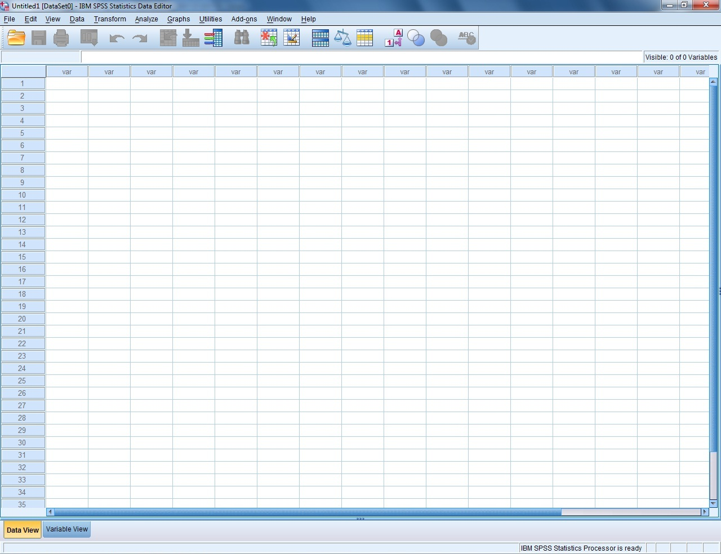
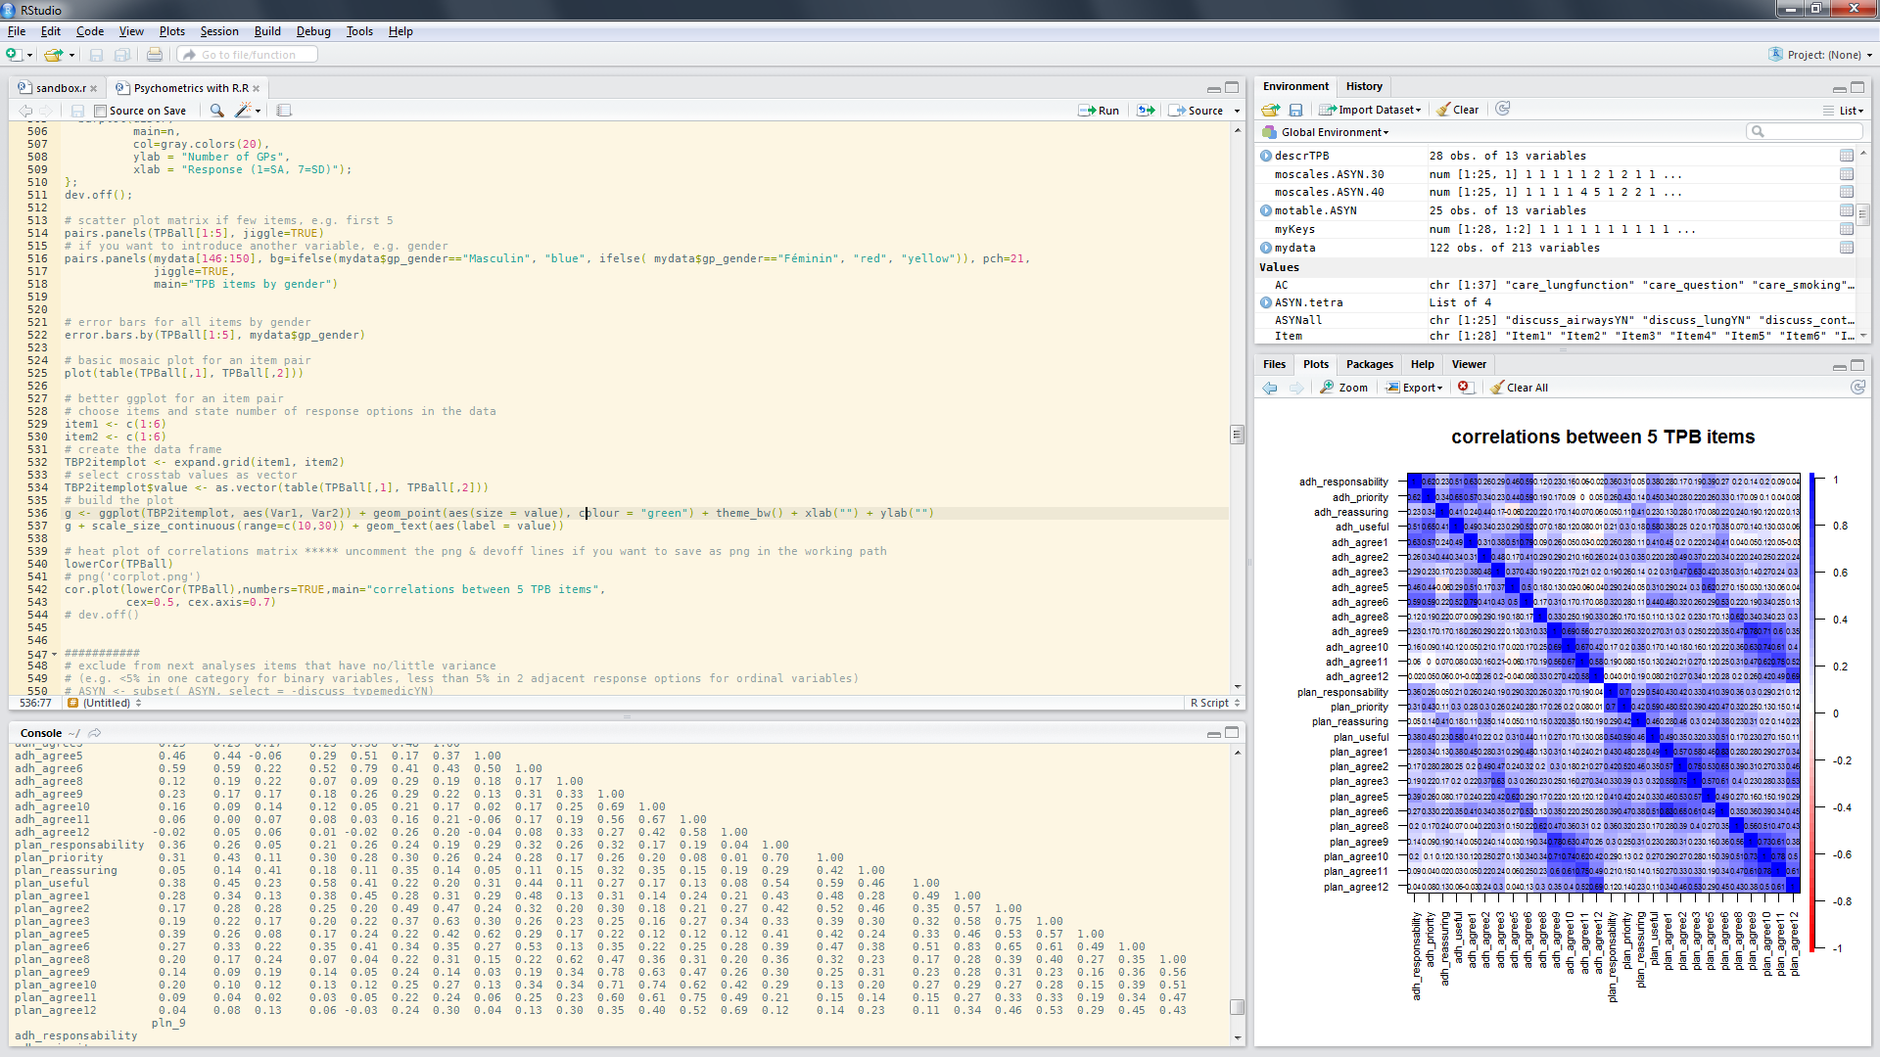
What you need to know about R
Programming language (free version of S+)
Since the 90ies, rapid development
Core team of developers
Many contributors
Mainly statistics
Now main stream
Excellent resources available
SPSS:
1 software
1 dataset
1 syntax file
1 output file
menu or syntax-based
R & R studio:
2 softwares + R packages
1 or more datasets
1 script editor
Many outputs
scripts

Slide 5
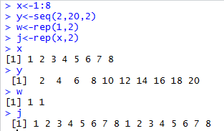
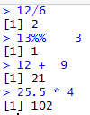
What you need to know about R
environment
packages
Data
Value
Function
Value
Data
Function
objects
Value
Data
operations
Function

Slide 6
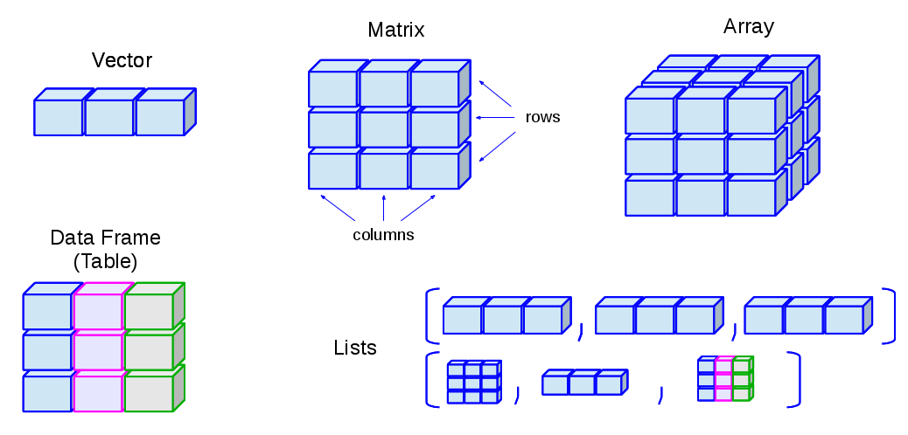

What you need to know about R
Data & Values
http://venus.ifca.unican.es/Rintro/_images/dataStructuresNew.png

Slide 7
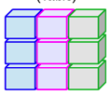
What you need to know about R
Data & Values
Data.frame (base R):
Data.table = data.frame, but better
In a package called ‘data.table’
Compatible with R code fit for data.frames
Much faster for large datasets
…
Try: example(data.table)

Slide 8
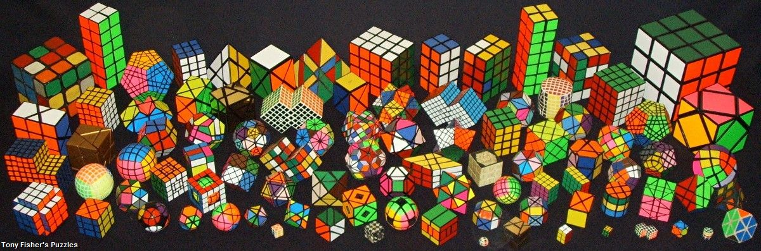
What you need to know about R
Data & Values

Slide 9
What you need to know about R

Slide 10
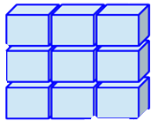
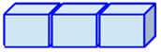
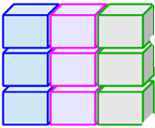
What you need to know about R
Data & Values
x <- matrix (1:12, nrow=3, ncol=4)
x <- 2 OR
2 -> x
x = 2
y <- “SA”
“SA” -> y
y = “SA”
x <- c (3, 4, 5)
x <- 3:5
OR
y <- c(“SA”, “N”, “SD”)
df <- data.frame (col1=c(10,20,30,40),
col2=c("a","b","c","a"),
col3=c(1, 2, 3, 4),
)
http://venus.ifca.unican.es/Rintro/dataStruct.html

Slide 11
What you need to know about R
Functions
function.name <- function (arguments)
{
purpose of function i.e. computations involving the arguments
}
x <- rnorm(100)
y <- x + rnorm(100)
plot (x, y)
my.plot <- function (..., pch.new=15) {
plot (..., pch=pch.new)
}
my.plot (x, y)
f1 <- function (x, y)
{
x+y
}
f1 (3, 4)
http://www.ats.ucla.edu/stat/r/library/intro_function.htm

Slide 12

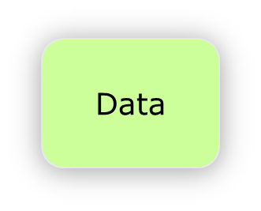
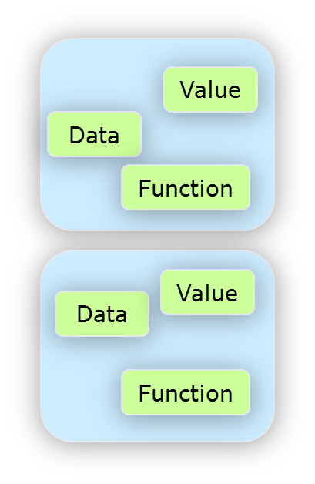
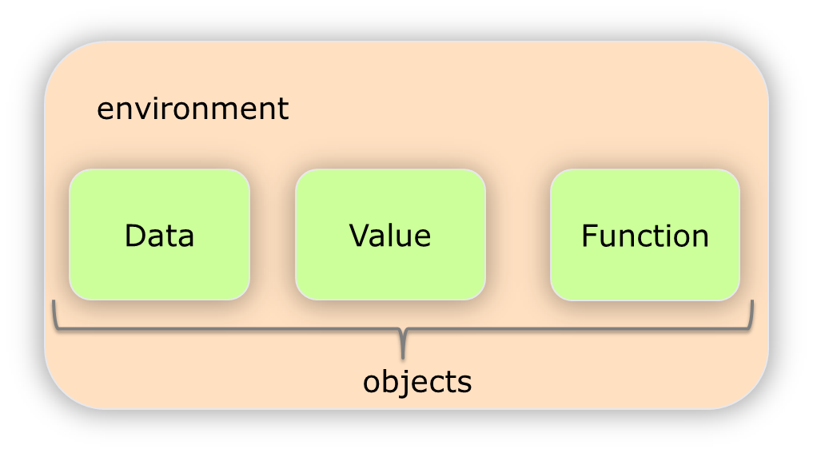
What you need to know about R

Slide 13
What about R studio

Slide 14
What about R studio
The 4 parts:
script editor
console
environment / history
files / plots / packages / help / viewer

Slide 16
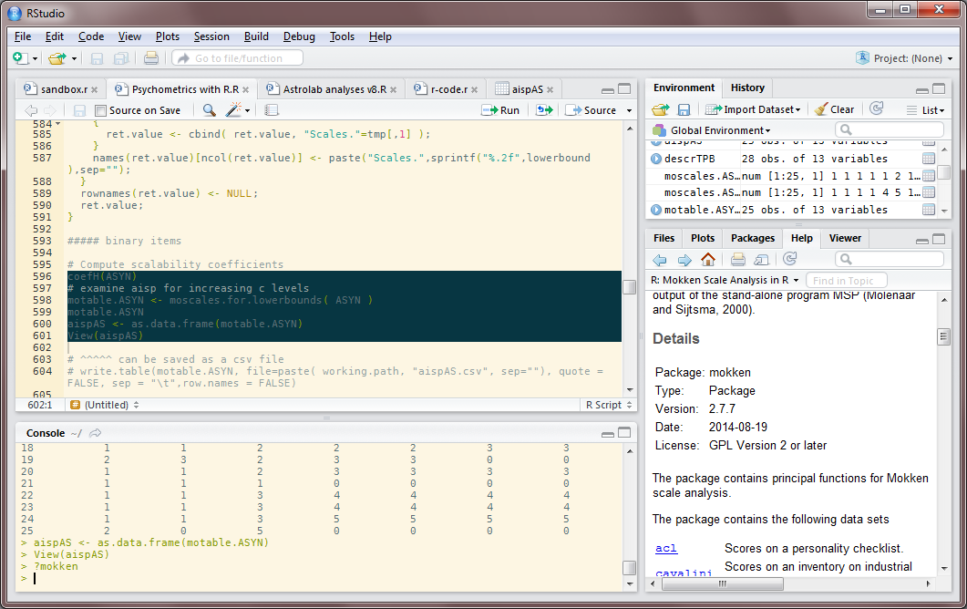
What about R studio
Script editor – SPSS syntax
# comments
Select & run
Find & replace
Easier writing

Slide 17
What about R studio
Console - records what is run from script
Up/down
change line
≈sandbox
all → envmt
Watch the > !!
If +, it is waiting
If text:, it asks
something

Slide 18
What about R studio
Environment- All objects
Data
Values
Functions
(from script
or console)
History –
all commands
from console
(rarely used)

Slide 19
What about R studio
Files
Plots
- All graphs
Packages
Help
- All answers
for ?command
Viewer

Slide 20
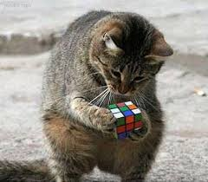
Now we can begin…
Open R studio
File -> Open file -> abcRcode.r

Slide 21
File -> Open file -> templatereport.rmd
Click Knit → analysis report ready!
File -> Open file -> descriptives.rmd
Do the exercises & Knit!
R basics
http://cran.r-project.org/doc/contrib/Torfs+Brauer-Short-R-Intro.pdf
http://tryr.codeschool.com/
Markdown http://rmarkdown.rstudio.com/lesson-1.html
…and then:
http://swirlstats.com/
http://r4ds.had.co.nz/

